Slide 1
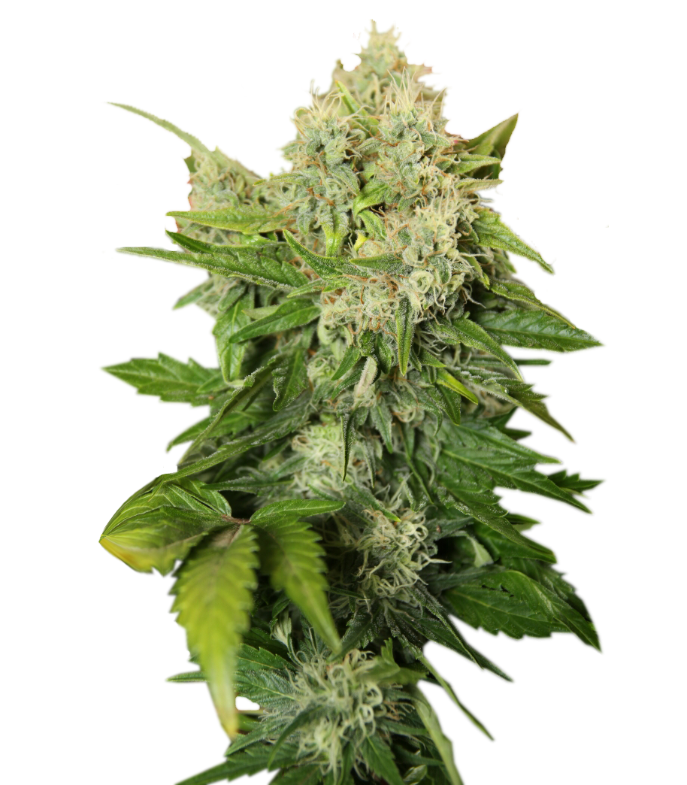
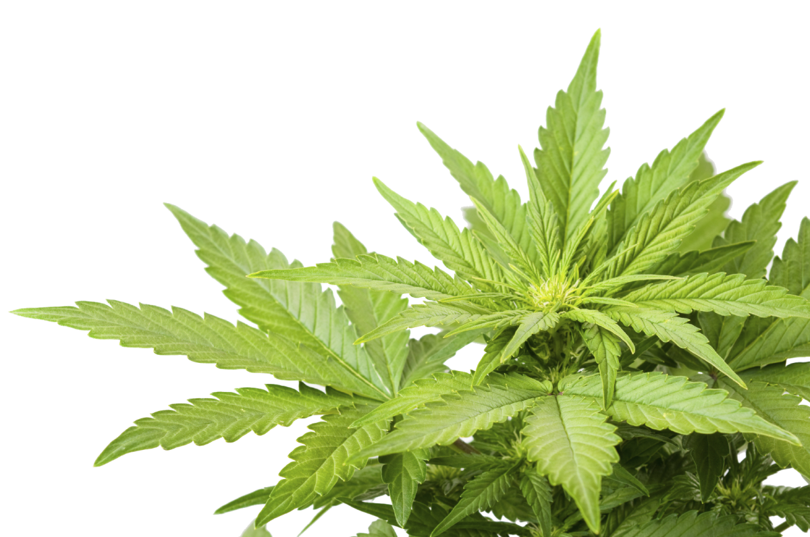
Capstone Project
Cannabis
Recommendation
System
Bailee Buckner

Slide 2


Slide 3


Background
For centuries, the cannabis plant has been used in medicinal, recreational, and industrial situations. It’s been used to treat various conditions such as chronic pain, anxiety, epilepsy and depression. Alternatively, some people just use it for funsies to relax after a long day. Different cannabis strains produce different effects and are bred for different things. However, many users, new and old, lack the knowledge about the specific strain effects to make an informed decision on which one they should choose. Often time, people rely on anecdotal advice from online communities or budtenders, which can be subjective and inconsistent. Some apps already available can provide strain information and reviews, but they often lack advanced personalization and accuracy. Here at Mad Cat Cannabis Co. we’ll help you Discover Your Roar by providing personalized strain recommendations based your individual symptoms.

Slide 4
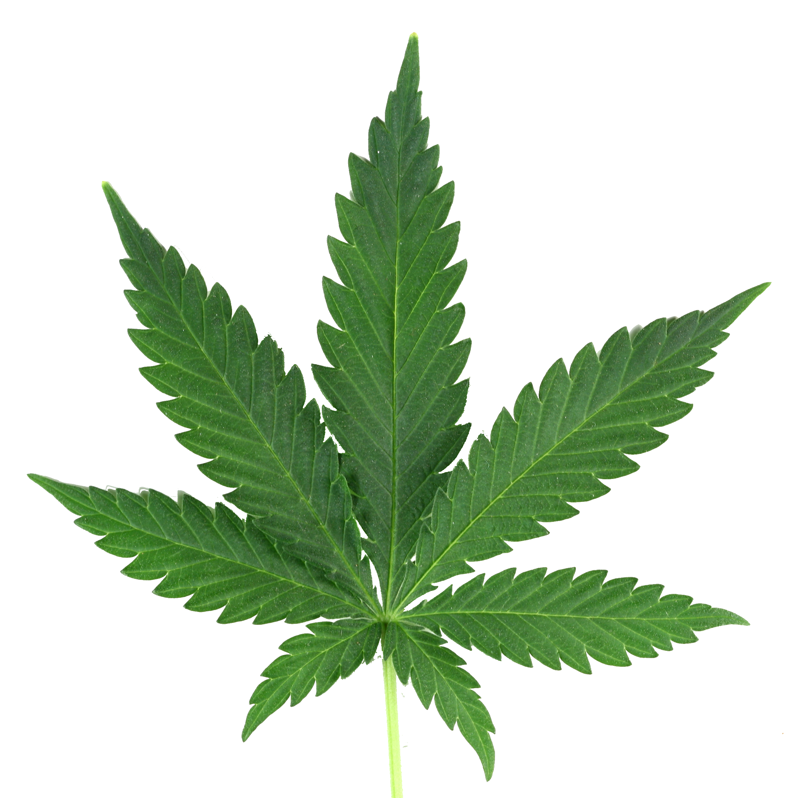
Overview of Methods
The Dataset: This dataset came from DoltHub, a company that publishes a wide variety of datasets
Data Cleaning: Took a lot of cleaning. Lots of null (empty) values that would affect how the model performs so they had to be manually fixed
Data Analysis and Visualizations: Looked at summary statistics. Created distribution graphs for strain effects, strain type, flavors and strain rating
The Model: Built a recommender system that suggest strains based on user symptoms
Showing off the Model: Used Streamlit to build a webpage to demonstrate our model

Slide 5
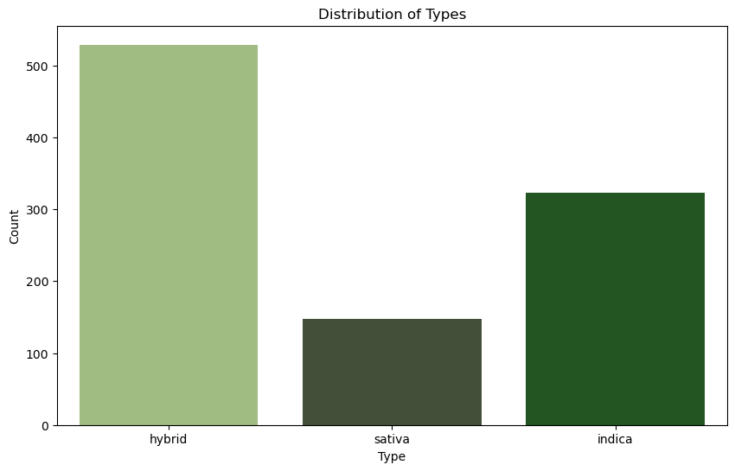

Slide 6
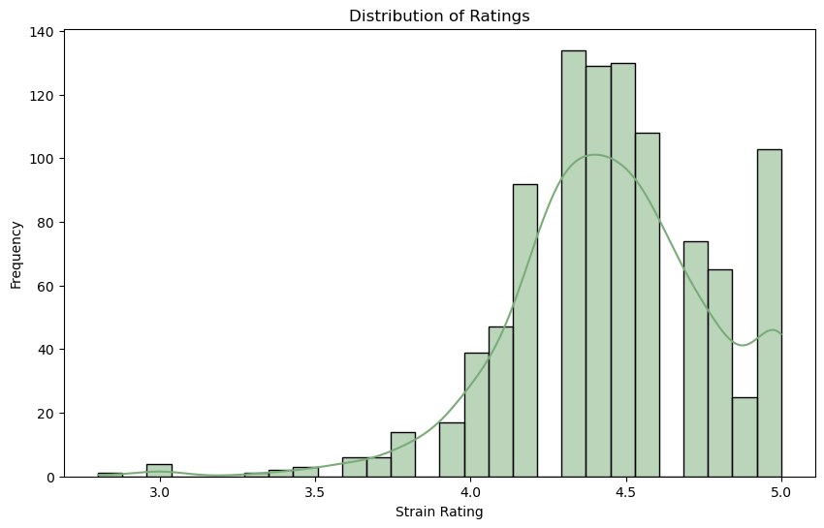

Slide 7
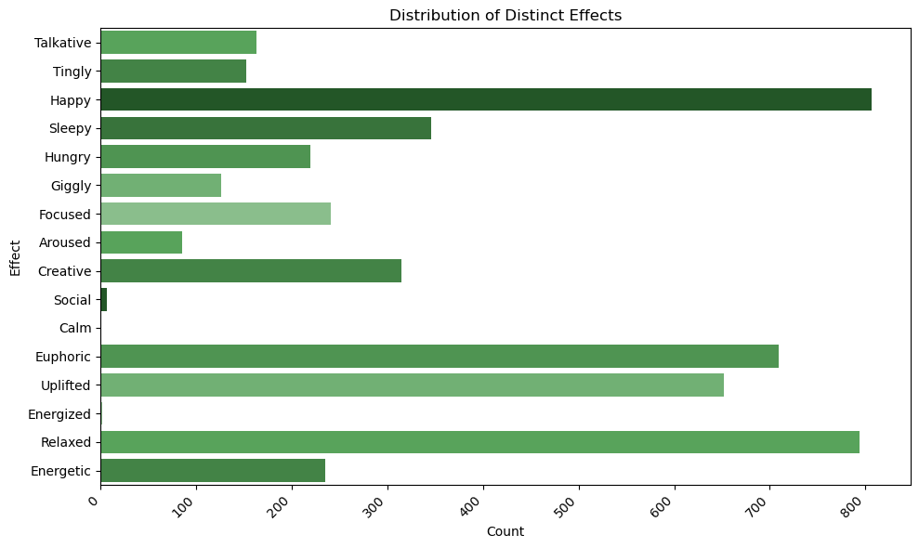

Slide 8
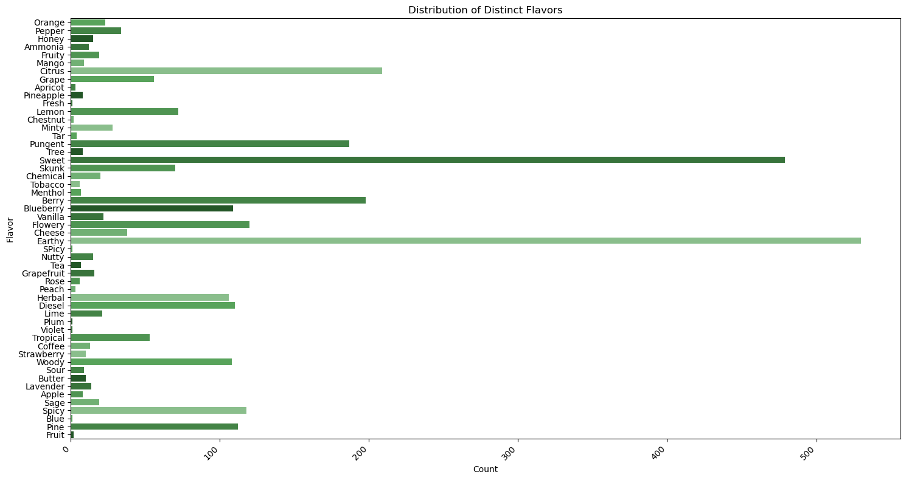

Slide 9
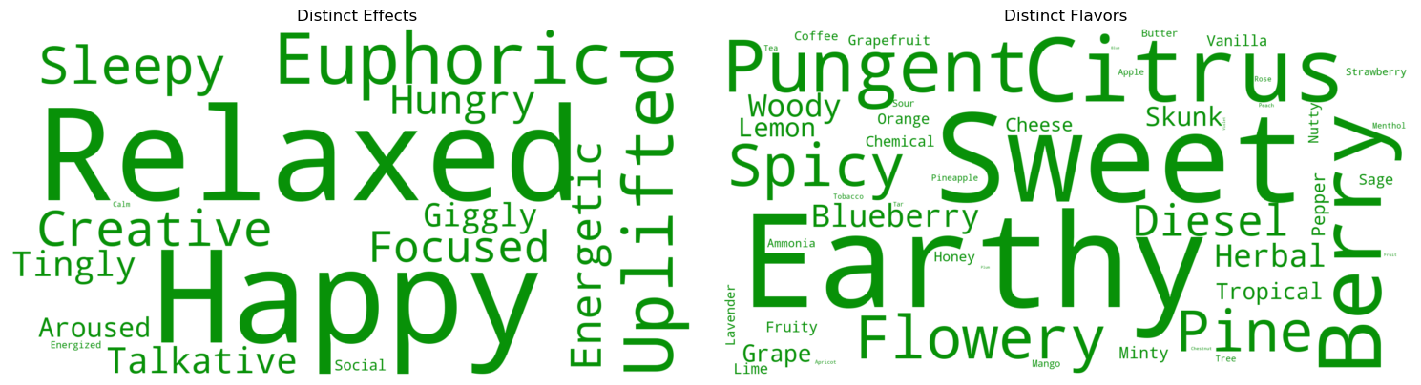

Slide 10
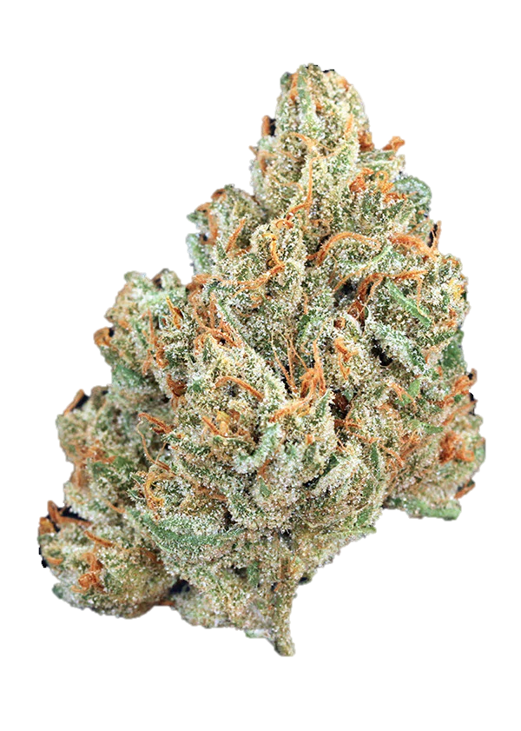
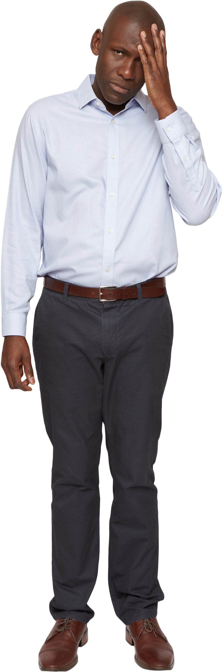


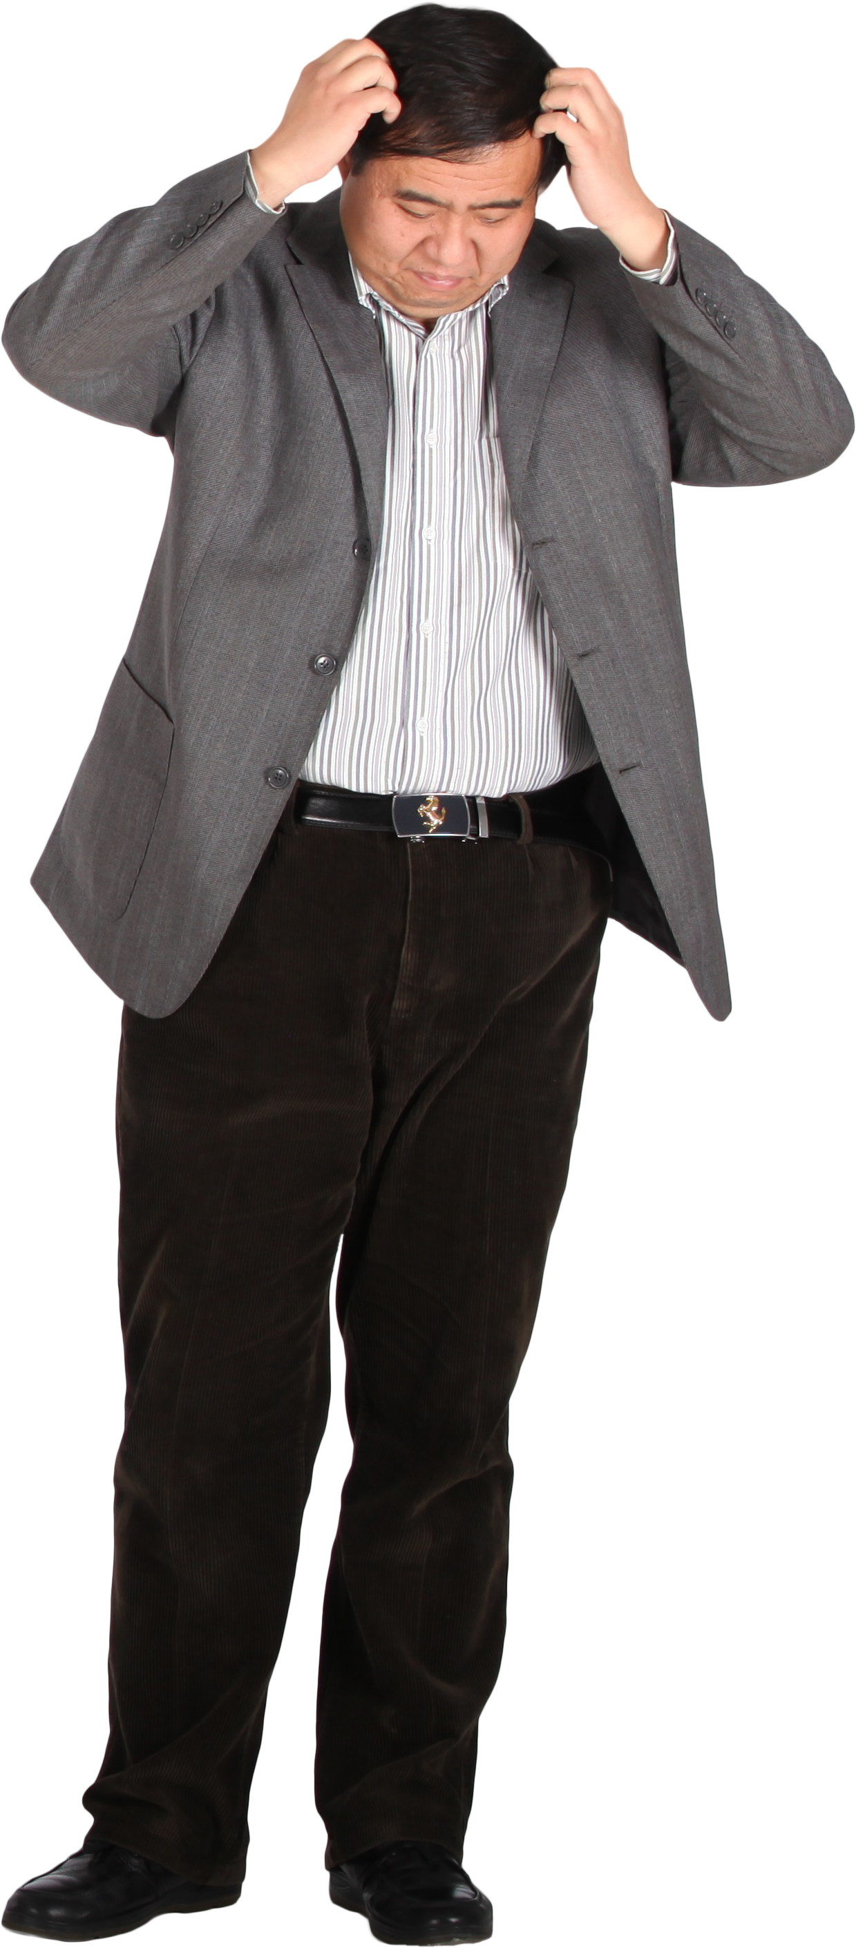
How the Model Works
Tell the model what’s wrong
Computing
Symptoms….
Out comes a list of strains best suited for your specific needs
Want to see it in action??

Slide 11

Conclusions and Next Steps
Better Dataset: The DoltHub dataset hasn’t been updated in four years, so the model is not up to date with current strains
More Diverse Effects and Symptoms: A more comprehensive list of symptoms and their effects would improve the model’s recommendations
Collaboration with Experts: Collaborate with cannabis industry experts, healthcare professionals, researchers, and regulatory entities to validate recommendations
User Response Data: In order to see if the model is properly working and fine tune it, user data should be collected and added to see if the recommended strain is accurately treating their symptoms
The Future: If used and implemented properly, this could cut down on time spent in dispensaries, less time and money spent on cannabis that doesn’t work for you. All in all, our model promotes responsible use and informed decision-making

Slide 12

Thank You!!
Thank you all for coming to my presentation today but a special thank you to the GA instructors, my classmates and my family for supporting me on this journey :)

